Slide 1
Project Handbook
Date

Slide 2
Purpose
Cooperation of team members
Project Organization
Project Execution

Slide 3
Content
Project Organization
Requirements Management
Project Planning
Configuration Management
Quality Assurance
Methods and Tools

Slide 4
Project Organization
Project Manager
Developer
Test Manager
Tester
Configuration Manager
Requirements Manager

Slide 5
Requirements Management
Slide to be removed!
Methods
Interview, Questionnaire, CRC-Cards, ...
Storage
Spreadsheet, Text Document, Data base, ...
Update Mechanism
How often and when

Slide 6
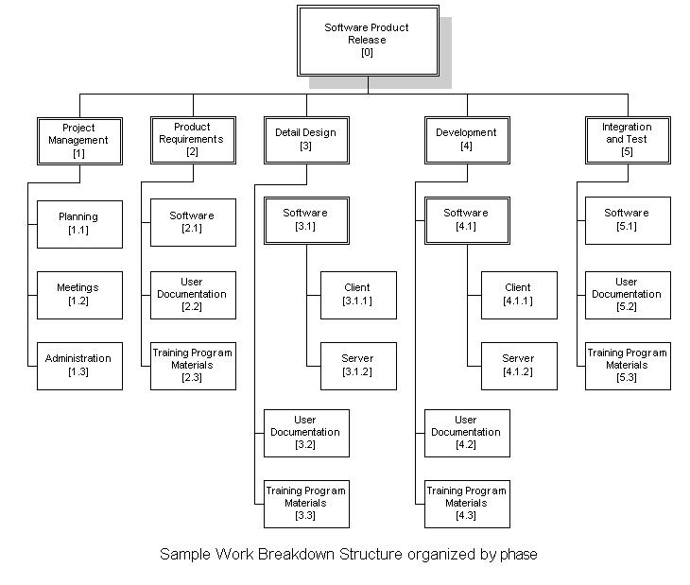
Project Planning – WBS

Slide 7
Project Planning –
List of Milestones
Date/Termin | Milestone/Meilenstein | Label
yyyy/mm/dd | Project Proposal released | <PROJECTNAME>_01.00.00
yyyy/mm/dd | Project Handbook released | <PROJECTNAME>_01.01.00
yyyy/mm/dd | System Specification (overall structure ok) released | <PROJECTNAME>_01.02.00
yyyy/mm/dd | Acceptance Tests released | <PROJECTNAME>_01.03.00
yyyy/mm/dd | Effort Estimation/Schedule (first guess) released | <PROJECTNAME>_01.04.00
yyyy/mm/dd | First software release (release of first base line) | <PROJECTNAME>_02.00.00
... | ... | ...

Slide 8
Configuration Management
Filing Structure
Project Planning
Requirements
Design Docs
Source Code
Testing
Filing structure cont.
Meeting Minutes
Templates
Versioning Methods & Tools
Which Documents versioned
When new Project Versions
Templates

Slide 9
Configuration Management –
Change Management
Change Requests
Change due to modified spec after “spec freeze”
Bug Report
Change due to non spec compliant behavior of software
Escalation Management
What to do in unforeseen situations

Slide 10
Quality Assurance
Test Plan
Test Specification
Test Protocol
Test Report

Slide 11
Test Plan
Test Type | Description | DUT | Planned Execution
Acceptance Test | Test which is basis for the decision whether the product will be accepted by the customer/supervisor | Complete software on the target hardware. | At version <PROJECTNAME>_xx.yy.zz and further
Integration Test | Test the combination of different software modules | Combination of the modules already implemented modules. | Starting with version <PROJECTNAME>_02.00.00; every two weeks then
Unit Test | Test which ensures conformity of software and spec on class level. | Single classes. | With every commit of software into the repository

Slide 12
Test Spec
Test Case “Unsuccessful User Login”
Step # | User Action | Expected System Behavior
1 | Type user name | User name is seen in the input field
2 | Type wrong password | Password characters are displayed hidden; A ‘*’ for each character entered
3 | Press Login Button | The login screen with an error message as given in Fig. 3.6 in the System Specification has to be presented

